Slide 1


Apache Kafka
an open-source distributed event streaming platform
Prepared by Ameen Hashir
Date : 24 Mar 2021

Slide 2
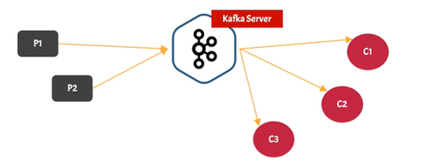
Introduction
Kafka is a messaging system
Kafka Vs Queue (RabbitMQ)

Slide 3
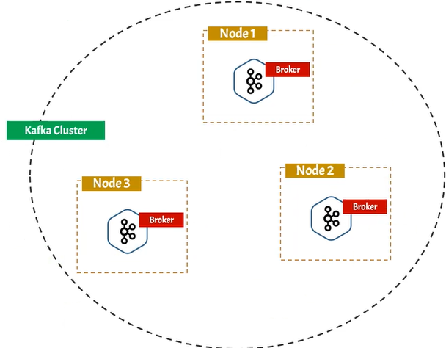
Kafka is distributed application
Referred as Kafka Cluster
A cluster made up of more than one Kafka server
Each Kafka server is called Kafka Broker

Slide 4
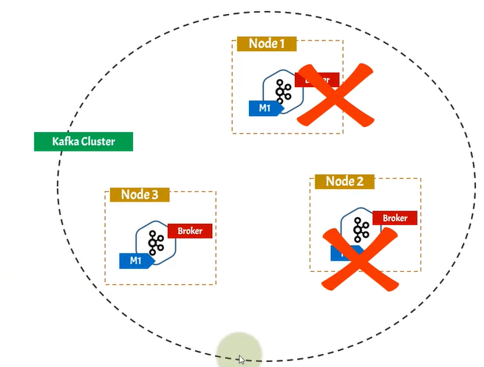
Kafka is fault Tolerant
Ability of system to continue operating even one or more component fails
In Kafka cluster message can be replicated in multiple brokers called Replication Factor

Slide 5
Kafka is scalable system
New Broker can be added anytime
01
Increase number of consumers
02
Kafka can take 1million requests per second
03

Slide 6
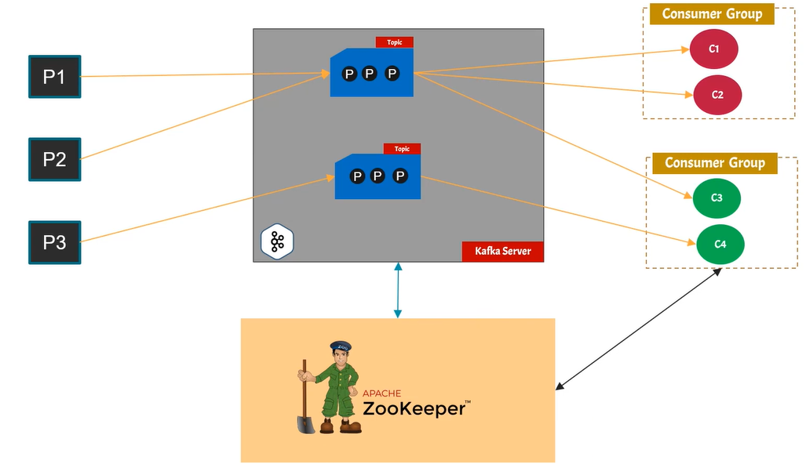
KAFKA Architecture
Kafka Server
Topics
Partition
Publisher/Producer
Consumer Group - consumer
A consumer must be associated with a consumer group
Zookeeper - is a distributed open-source configuration, synchronization service
All the data regarding no: of producers , consumers etc. are stored in zookeeper
Which message has been read by consumer
Cluster information - location ip etc.
Topic configuration

Slide 7
Install Kafka Server and Zookeeper
Search Keyword : Kafka download
URL : https://kafka.apache.org/downloads - Top Menu - GET STARTED -> QUICK START
Click on Step 1 -> Download
wget https://downloads.apache.org/kafka/2.7.0/kafka_2.13-2.7.0.tgz
Copy file to /opt --if needed
sudo tar -xvzf kafka_2.13-2.7.0.tgz

Slide 8
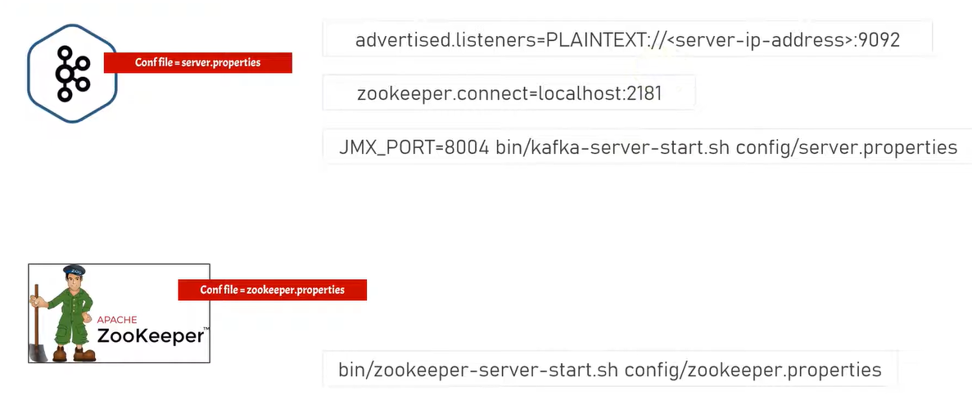
Configuration
Kafka: /config/server.properties
Zookeeper : /config/zookeeper.properties

Slide 9
Start Kafka Broker
Step1 : Start Zookeeper
./bin/zookeeper-server-start.sh config/zookeeper.properties
Step2: Start Kafka Broker
./ bin/kafka-server-start.sh config/server.properties
Ports : Kafka Server - 9092 / Zookeeper - 2181
Connect to Kafka Broker using "Kafka tool“ and create Topic

Slide 10
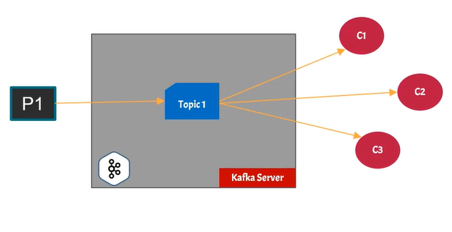
Kafka Topic
Topic is Kafka component where producers are connected
Producer publish messages in Kafka topic
Topic in Kafka is multi subscriber
Topic is a logical Entity

Slide 11
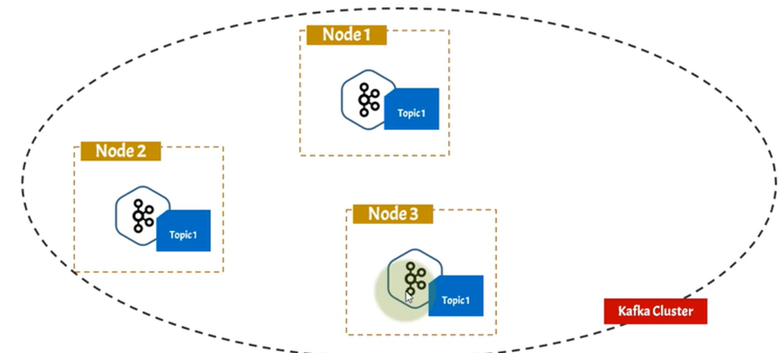
Kafka Topic in Cluster
In Kafka cluster each Topic is present in every cluster node

Slide 12
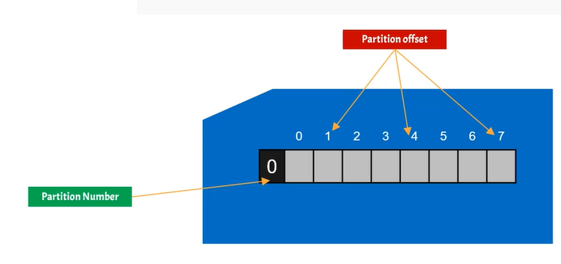
Kafka Topic Partition
Kafka topic is divided into multiple parts called partition
A partition is a linear data structure , like array
Messages are published to topic partition
Every partition has a partition number [ starts with 0 ]
Has an increasing index called offset.
New messages are always push to partition end , partition is immutable

Slide 13
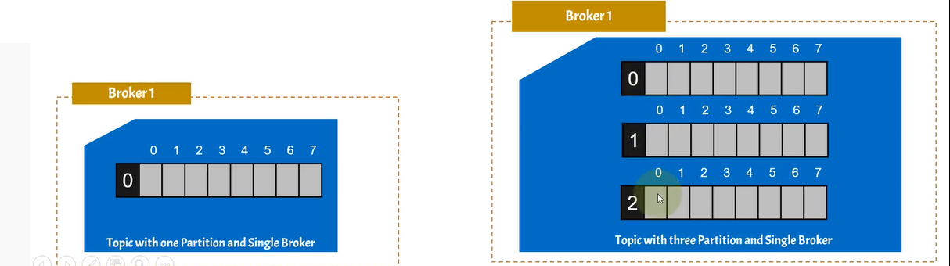
Multiple Partitions

Slide 14
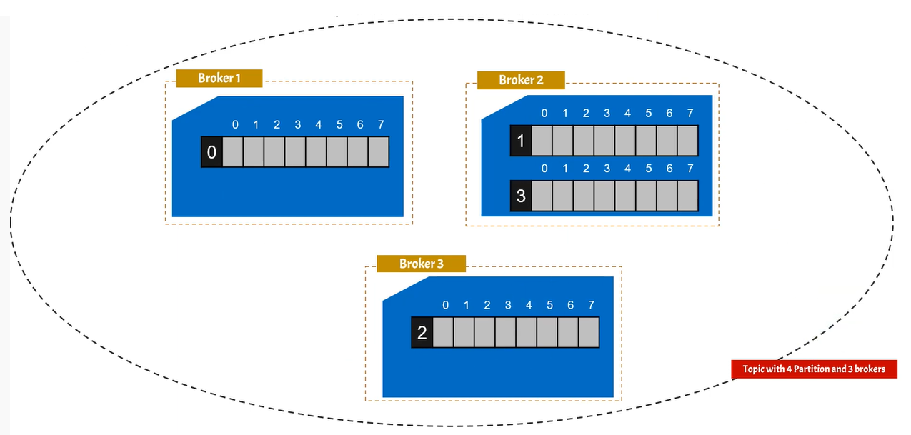
Multi Broker Kafka Custer - Partition distribution

Slide 15
Replication Factor in Kafka
Kafka is fault tolerant
It is a distributed system
Each partition is replicated across multiple servers for fault tolerance , since it’s a distributed system
Only one partition will be active which is called a leader.
All read and write operations occurs in leader partition
Other partitions are called followers which simply copies the leader partition data and remains silent in operation.

Slide 16
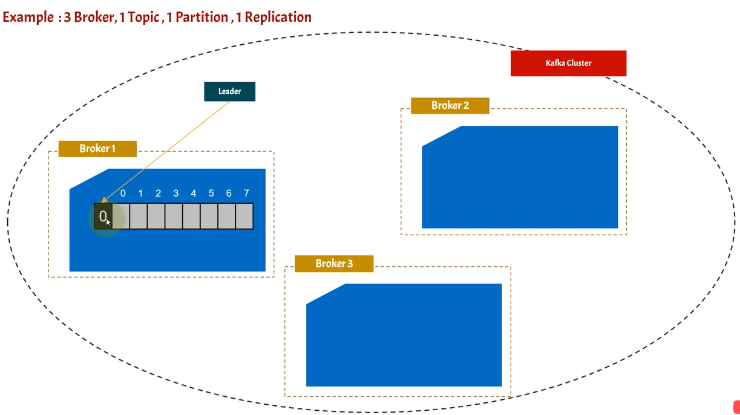

Slide 17
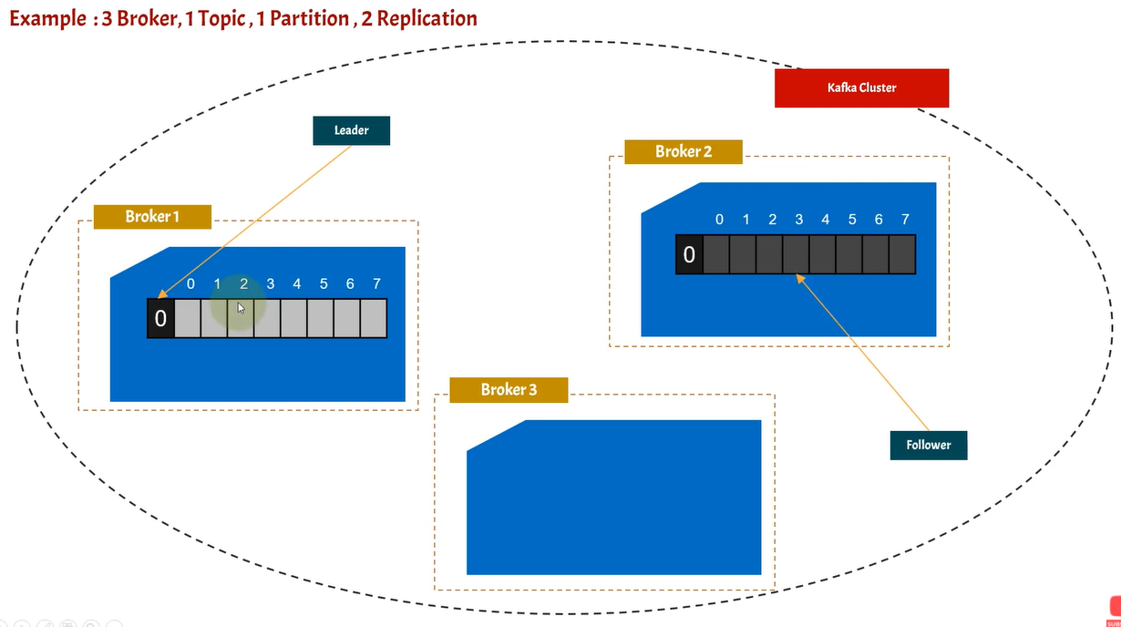

Slide 18
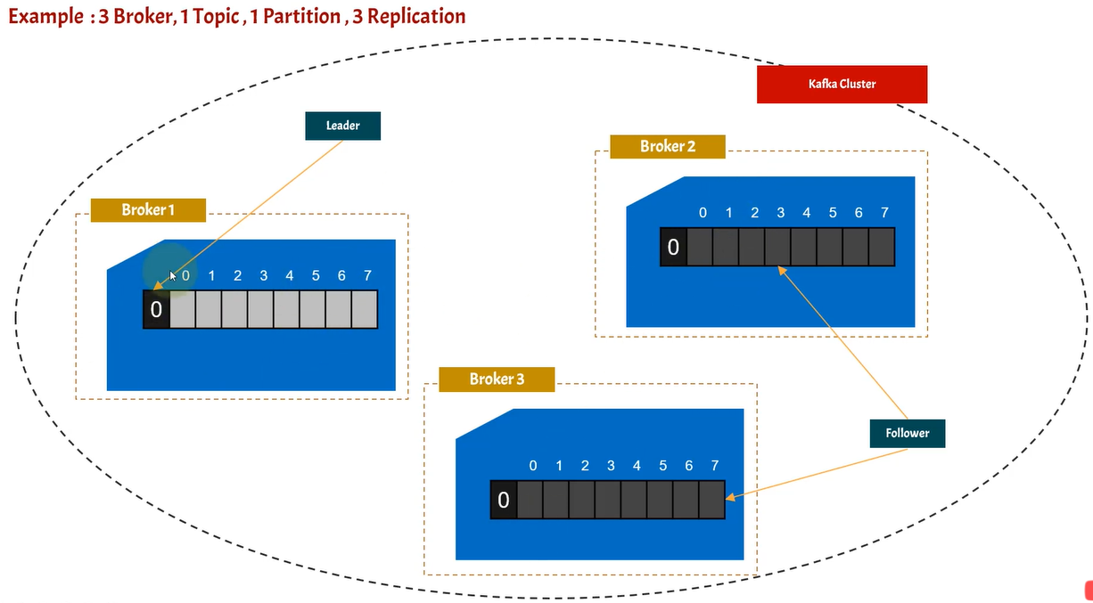

Slide 19
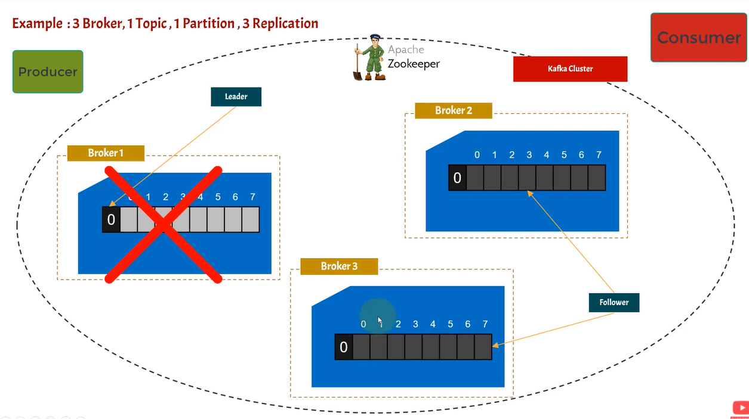
Producer publishes message to Broker 1 partition since it is leader
This partition is replicated to Broker 2 & 3 topic partitions
Consumers consumes only from Broker 1 partition since it's the leader
When Broker 1 goes down ,Zookeeper will elect a leader from remaining 2 partitions and assign a leader
Then the same process continues.

Slide 20
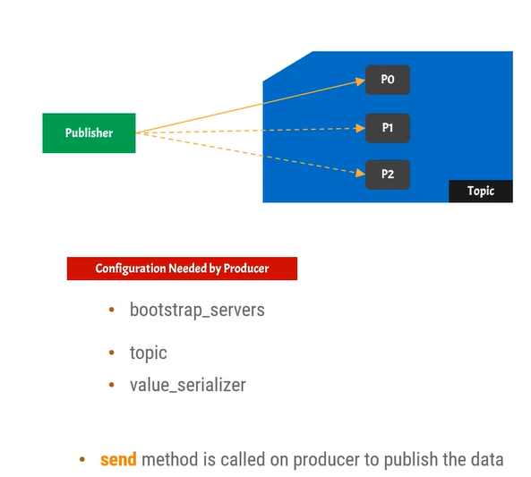
Producer – Python code
Install:
pip install kafka-python
pip install Faker
https://github.com/ameenhashir/kafka/tree/master/workspace/kafka-app-demo/venv
Generate Faker data data.py
Producer producer.py
Producer for particular partition producer_single_partition.py

Slide 21
FAKER – Generate Fake Data
File Name : data.py
from faker import Faker data = Faker() def generate_data(): return {'name':data.name(),'address':data.address(),'created_on':data.year()} if __name__ == '__main__': print(generate_data())

Slide 22
Producer
File Name : Producer.py
from kafka import KafkaProducer import json from data import generate_data import time def get_serialized(data): return json.dumps(data).encode('utf-8') if __name__ == '__main__': producer = KafkaProducer(bootstrap_servers=['10.152.21.186:9092'],value_serializer=get_serialized) while True: data = generate_data() print(data) producer.send('registered_user',data) time.sleep(4)

Slide 23
Producer - Specific Topic Partition
from kafka import KafkaProducer import json from generate_data import generate_data import time def get_serialized(data): return json.dumps(data).encode('utf-8') def get_partition(keybytes,allpartition,availablepartition): return 0 if __name__ == '__main__': producer = KafkaProducer(bootstrap_servers=['10.152.21.186:9092'],value_serializer=get_serialized,partitioner=get_partition) while True: data = generate_data() print(data) producer.send('registered_user',data) time.sleep(4)

Slide 24
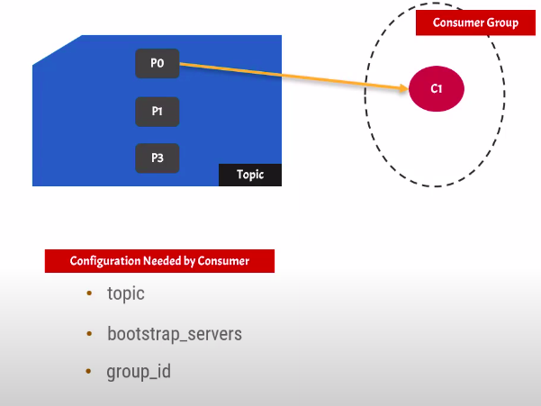
Consumer
Consumer is Kafka component that consumes messages from Kafka topic
Internally consumer consumes messages from Kafka topic Partition
Every consumer assigned to Consumer group
If no group_id provided , then random group is assigned

Slide 25
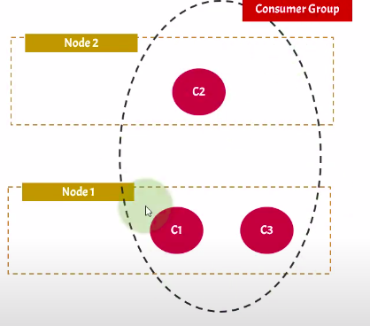
Consumer Group
Logical grouping of one or more consumers is called consumer group
Mandatory for a consumer to register to a consumer group
Consumer instances are separate process
Consumer instance of same consumer group can be on different nodes

Slide 26
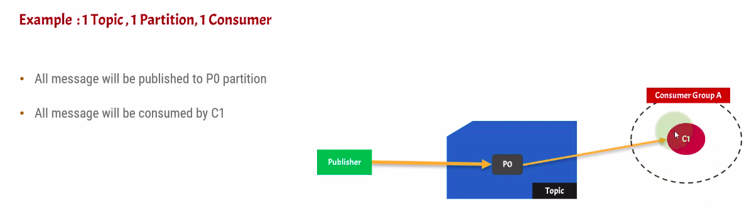
Consumer – Python code
https://github.com/ameenhashir/kafka/tree/master/workspace/kafka-app-demo/venv
Code : consumer.py
Create a topic with 1 partition with 1 Broker
Run producer.py to produce to topic partition
Run Consumer.py to consume
Check Kafka Tool the same to verify

Slide 27
from kafka import KafkaConsumer import json if __name__=='__main__': consumer = KafkaConsumer('registered_user', bootstrap_servers=['10.152.21.186:9092'], auto_offset_reset='latest', group_id='consumergrp1') while True: for msg in consumer: print(msg.partition,'-',json.loads(msg.value))

Slide 28
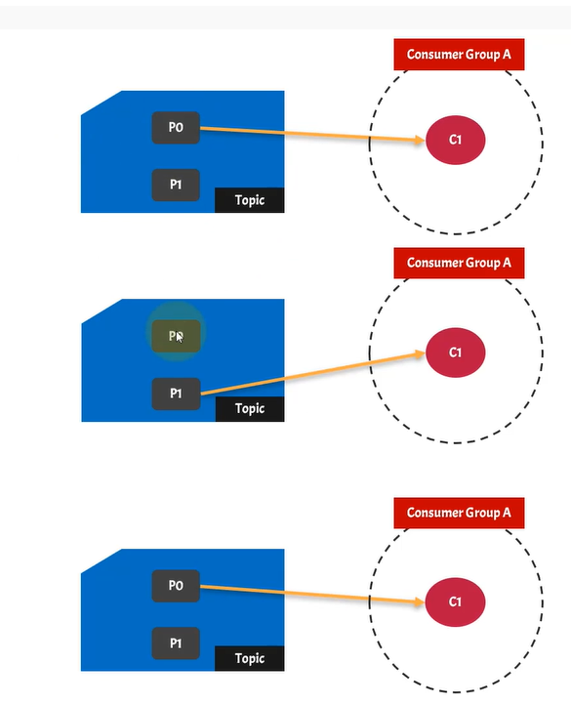
Consumer group in Kafka with 1 topic 2 partition 1 consumer
Message will be published to partition randomly since we not mentioned any specific partition in producer
Message will be consumed by C1 consumer in a round robin fashion from both partitions , since we have only one consumer.
One consumer in a consumer group, can consume message from more than one partition , if no: of consumers in consumer group in less than the partitions in topic.

Slide 29
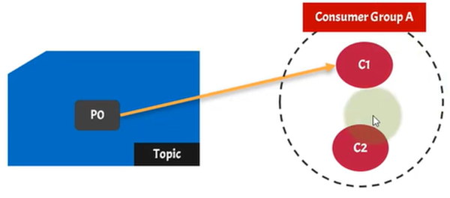
Consumer Group in Kafka with 1 Topic 1 partition and 2 consumer
2 consumers are registered to same consumer group
Since there is only one partition , one consumer will sit idle
Same partition can't be assigned to multiple consumers in same consumer group

Slide 30
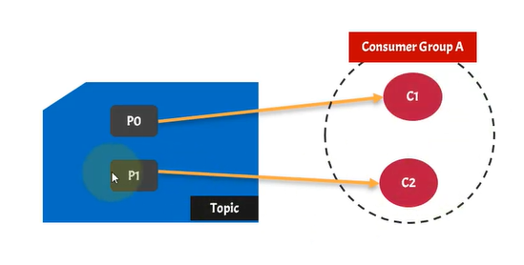
Consumer group in Kafka with 1 Topic 2 partition and 2 consumer
If there is more than 1 partition and more than 1 consumer, each consumer in a consumer group will be assigned to one specific partition in topic.

Slide 31
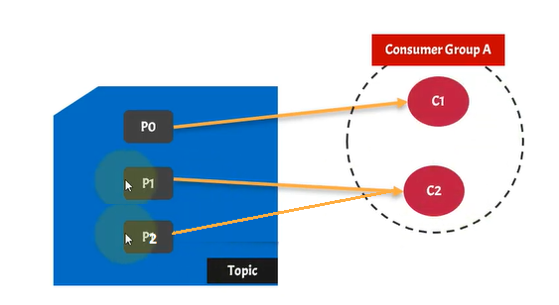
Consumer group in Kafka with 1 Topic 3 partition and 2 consumer
One consumer reads from 2 partition in round robin fashion
2nd consumer will read dedicatedly from 3rd partition which his not read by 1st consumer.

Slide 32
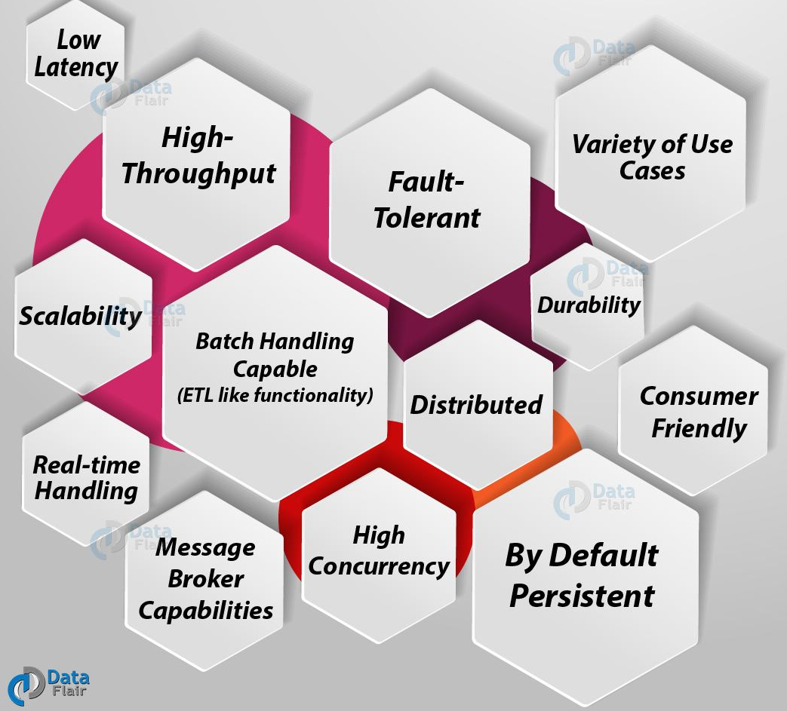
Advantages

Slide 33
Disadvantages
No Complete Set of Monitoring Tools It is seen that it lacks a full set of management and monitoring tools. Hence, enterprise support staff felt anxious or fearful about choosing Kafka and supporting it in the long run.
Issues with Message Tweaking As we know, the broker uses certain system calls to deliver messages to the consumer. However, Kafka’s performance reduces significantly if the message needs some tweaking. So, it can perform quite well if the message is unchanged because it uses the capabilities of the system.
Not support wildcard topic selection There is an issue that Kafka only matches the exact topic name, that means it does not support wildcard topic selection. Because that makes it incapable of addressing certain use cases.
Reduces Performance In general, there are no issues with the individual message size. However, the brokers and consumers start compressing these messages as the size increases. Due to this, when decompressed, the node memory gets slowly used. Also, compress happens when the data flow in the pipeline. It affects throughput and also performance.
Behaves Clumsy Sometimes, it starts behaving a bit clumsy and slow, when the number of queues in a Kafka cluster increases.
Lacks some Messaging Paradigms Some of the messaging paradigms are missing in Kafka like request/reply, point-to-point queues and so on. Not always but for certain use cases, it sounds problematic. So, this was all about the advantages and disadvantages of Kafka.
Lack of Pace There can be a problem because of the lack of pace, while API’s which are needed by other languages are maintained by different individuals and corporates.

Slide 34
Live Busline Tracker
https://github.com/ameenhashir/kafka/tree/master/workspace/RealTimeBusCoordinateMap
https://www.youtube.com/watch?v=xiouigXHqdE&list=PL2UmzTIzxgL7Bq-mW--vtsM2YFF9GqhVB&index=5
Generate Bus co-ordinates in json using https://geojson.io/#map=2/20.0/0.0
Java Script maps documentation : https://leafletjs.com/

Slide 35
Reference Materials
https://youtu.be/Hl61x0s3yeQ
https://kafka-python.readthedocs.io/en/master/
https://data-flair.training/blogs/advantages-and-disadvantages-of-kafka/

